Slide 1


Abdulelah Almajed
STEAM PRICE PREDICTION
Regression, Machine Learning Project

Slide 2
Content
01
Introduction
04
Data Warngling
02
Dataset
05
EDA
03
Tools
06
Models
07
Conclusion

Slide 3

Steam
Steam is a popular video game digital distribution service where gamers view and download games of their interest.
64% of US adults and 70% of US minors are considered gamers.

Slide 4
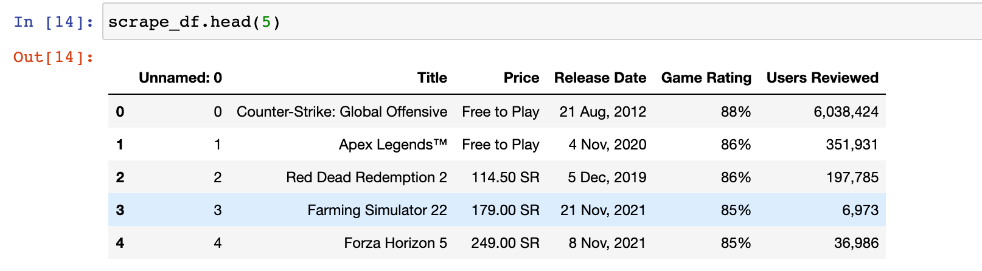
Scraped Dataset

Slide 5
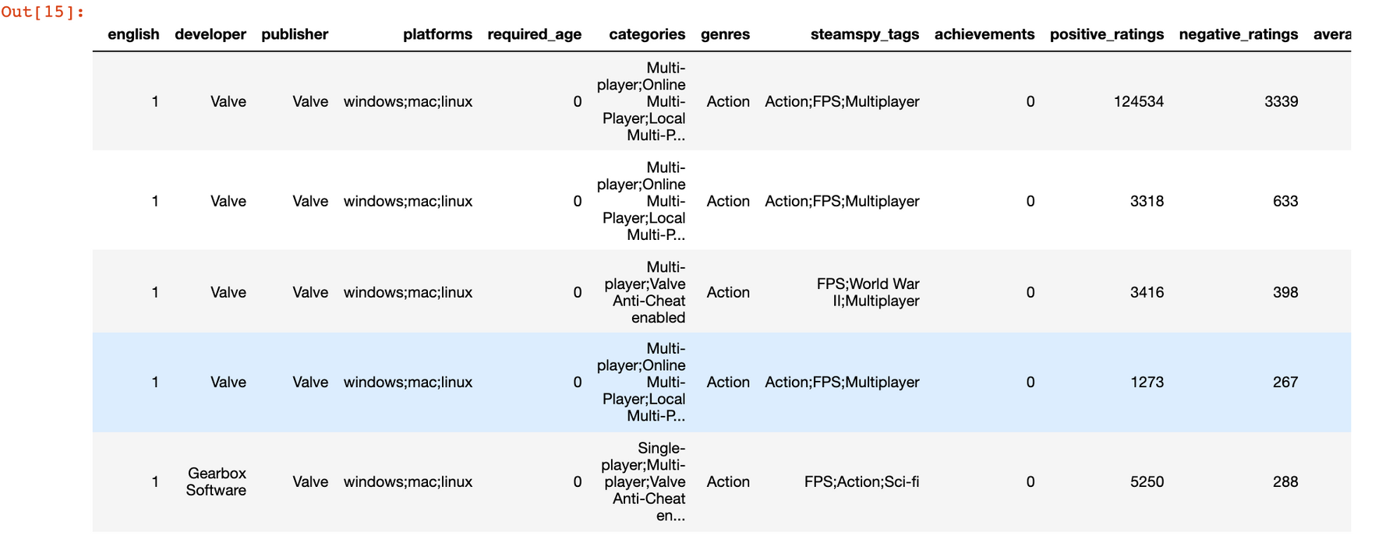
Another Dataset

Slide 6
Tools
Jupyter Notebook
Pandas
Numpy
Beautiful Soup & Selenium
Matplotlib & Seaborn
sklearn

Slide 7
Data Warngling
Data Arranging, Data Cleaning
Step 1
Step 2
Step 3
Merge two Dataset
remove Null Values & replace null values with mode
Create Dummy Variables

Slide 8
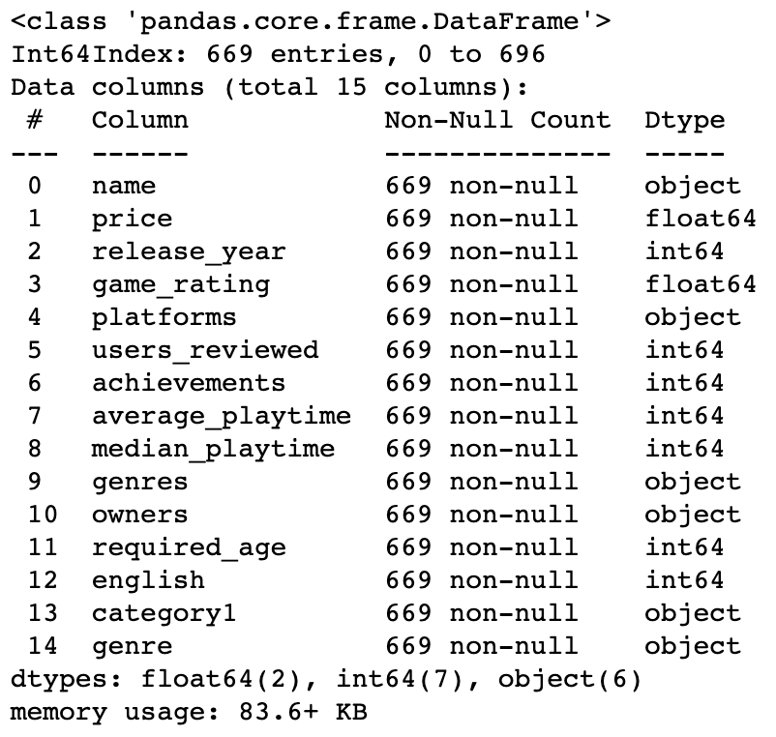
Dataframe info before dummies
669
Observations
15
Columns

Slide 9
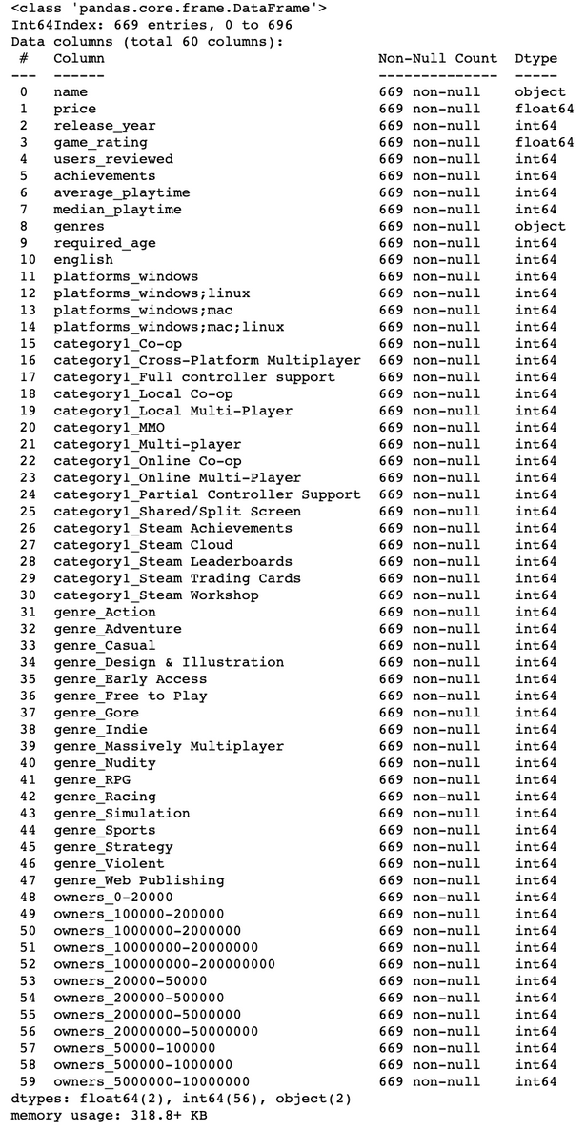
Dataframe info after dummies
669
Observations
60
Columns

Slide 10
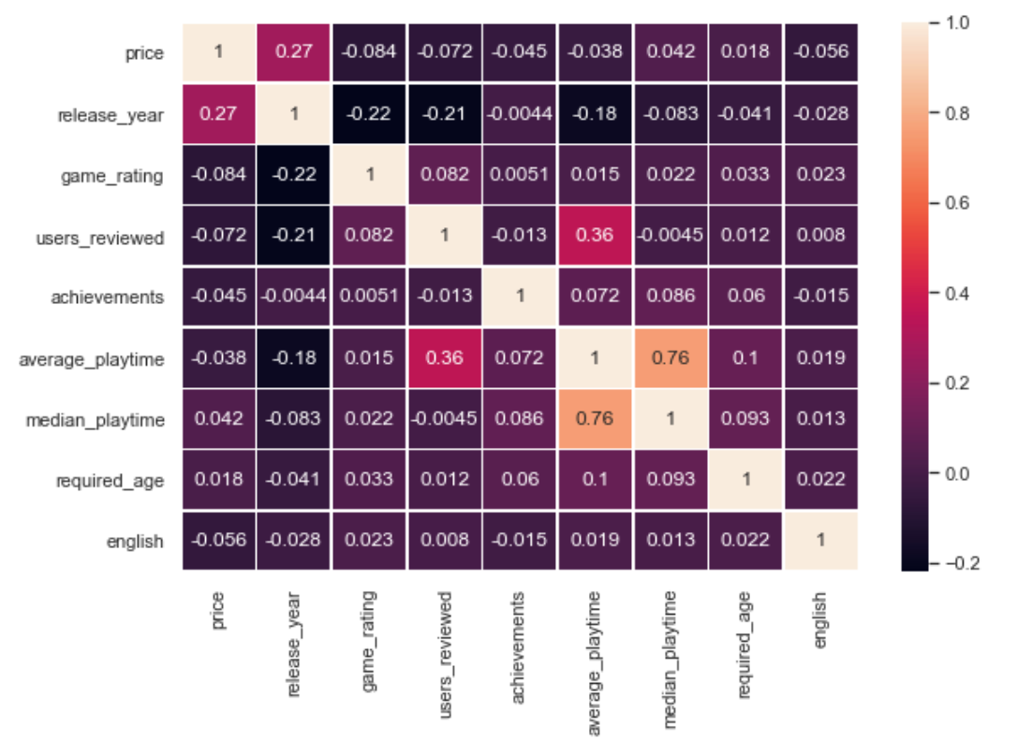
Heatmap

Slide 11
Dummies variables
Categories
Genres
Platforms
Owners
was about 16 column
was about 17 column
was about 4 column
was about 12 column

Slide 12

Linear Regression
Training and testing R^2
Training R^2 was : 0.18
Testing R^2 was: 0.045

Slide 13
Ridge Regression
Training and testing R^2
Training R^2 was : 0.024
Testing R^2 was: 0.013

Slide 14
Gradient Boosting Regression
Training and testing R^2
Training R^2 was : 0.67
Testing R^2 was: 0.91

Slide 15
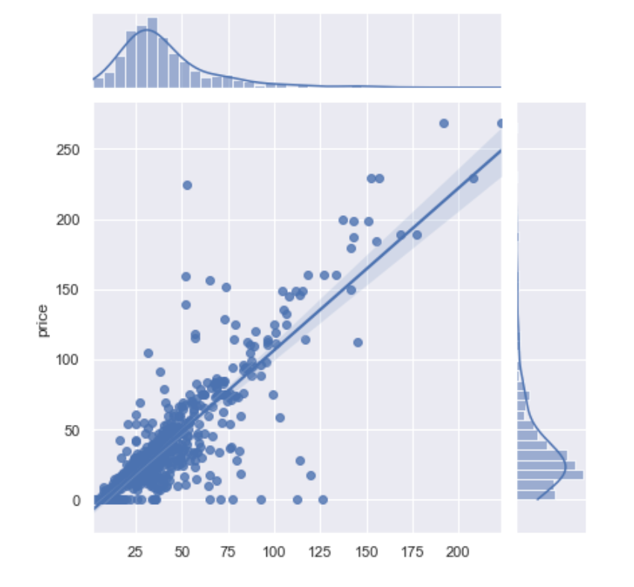
Best Model: Random Forest Regression
Training R^2 = 0.89
Testing R^2 = 0.88
Mean Square Error = 1385.0406909248802
Root Mean Square Error = 37.21613481979127
Mean Absoluter Error= 26.202058333333326

Slide 16
THANK YOU!

